Slide 1
INTRODUCTION TO SOFTWARE ENGINEERING

Slide 2
GROUP 7
FRANKYLNA FATMATA NYLANDER 905006245
ELIZABETH ROSE COLLIER 905006415
GEORGE N’GOLOMUSA KARGBO 905006239

Slide 3
EDU CORE EDUCATIONAL SYSTEM

Slide 4
1.1 INTRODUCTION
The EDU Core Learning Platform is designed as an architectural expansion of the initial assignment concept, formalizing it into a fully functional Digital Public Good (DPG) system.
This system specifically targets the structural educational crises within Sierra Leone, aligning comprehensively with the United Nations Sustainable Development Goal 4 (SDG 4: Quality Education).
In Sierra Leone, educational access was dramatically expanded via the 2018 Free Quality School Education (FQSE) initiative. However, severe quality deficits remain: over 30% of primary school educators failed foundational literacy and numeracy assessments in 2021, rural-urban disparities dictate public examination success, and severe instructional infrastructure bottlenecks remain unaddressed.
By formulating an open-source, ultra-low-bandwidth, AI-personalized mobile and PC platform, EDU Core provides accessible, self-paced learning resources that seamlessly cross-cut socio-economic divides.

Slide 5
2.1 LIFE CYCLE CHOOSEN
Why Agile Scrum Was Chosen
The decision to use Agile Scrum over a traditional, linear model (like Waterfall) is driven entirely by the challenging environment in which EDU Core operates.
Mitigation of Infrastructure Risks: In Sierra Leone, developers must contend with erratic power grids and intermittent edge networks. A linear model assumes requirements and environments remain stable. Agile allows the team to pivot immediately if a deployment strategy fails due to local network drops.
Rapid Feedback Loops in Real-World Conditions: Because over 30% of primary educators face foundational literacy gaps, the user experience (UX) must be heavily tailored. Agile’s short development cycles (Sprints) mean actual teachers and students in target demographics can test features early and often. Their feedback directly shapes the next version.

Slide 6
2.2 PHASE BY PHASE EXECUTION
Phase 1: Requirement Engineering & Analysis Functional constraints are gathered directly from local educational institutions, teachers, parents, and rural students. Key technical requirements established include cross-platform database replication, zero-data SMS notification protocols, and localized AI optimization algorithms. Artifacts generated include a prioritized Product Backlog.
.

Slide 7
Phase 2: Architectural & System Design System boundaries are defined. Database models are normalized, and structural diagrams are authored. During this phase, the core synchronization protocol—enabling offline SQLite engines to sync with cloud Postgres instances—is modeled via class schemas and state charts.
2.2 PHASE BY PHASE EXECUTION
Phase 1: Requirement Engineering & Analysis Functional constraints are gathered directly from local educational institutions, teachers, parents, and rural students. Key technical requirements established include cross-platform database replication, zero-data SMS notification protocols, and localized AI optimization algorithms. Artifacts generated include a prioritized Product Backlog.
.

Slide 8
Phase 3: Implementation & Coding Development is run across 2-week sprints. Front-end layers are authored using decoupled components, local database managers are compiled via SQLite, and cloud integration microservices are written in high-throughput frameworks. Source control is strictly managed over Git with modular feature branching.
2.2 PHASE BY PHASE EXECUTION
Phase 1: Requirement Engineering & Analysis Functional constraints are gathered directly from local educational institutions, teachers, parents, and rural students. Key technical requirements established include cross-platform database replication, zero-data SMS notification protocols, and localized AI optimization algorithms. Artifacts generated include a prioritized Product Backlog.
.
Phase 2: Architectural & System Design System boundaries are defined. Database models are normalized, and structural diagrams are authored. During this phase, the core synchronization protocol—enabling offline SQLite engines to sync with cloud Postgres instances—is modeled via class schemas and state charts.

Slide 9
Phase 4: Testing & Integration The platform undergoes rigid testing matrix execution, spanning automated unit testing for AI models, end-to-end simulation of multi-user sync patterns, and validation of low-data offline states. Bandwidth throttling is systematically simulated down to 2G EDGE speeds to ensure synchronization consistency.
2.2 PHASE BY PHASE EXECUTION
Phase 1: Requirement Engineering & Analysis Functional constraints are gathered directly from local educational institutions, teachers, parents, and rural students. Key technical requirements established include cross-platform database replication, zero-data SMS notification protocols, and localized AI optimization algorithms. Artifacts generated include a prioritized Product Backlog.
.
Phase 2: Architectural & System Design System boundaries are defined. Database models are normalized, and structural diagrams are authored. During this phase, the core synchronization protocol—enabling offline SQLite engines to sync with cloud Postgres instances—is modeled via class schemas and state charts.
Phase 3: Implementation & Coding Development is run across 2-week sprints. Front-end layers are authored using decoupled components, local database managers are compiled via SQLite, and cloud integration microservices are written in high-throughput frameworks. Source control is strictly managed over Git with modular feature branching.

Slide 10
2.2 PHASE BY PHASE EXECUTION
Phase 1: Requirement Engineering & Analysis Functional constraints are gathered directly from local educational institutions, teachers, parents, and rural students. Key technical requirements established include cross-platform database replication, zero-data SMS notification protocols, and localized AI optimization algorithms. Artifacts generated include a prioritized Product Backlog.
.
Phase 2: Architectural & System Design System boundaries are defined. Database models are normalized, and structural diagrams are authored. During this phase, the core synchronization protocol—enabling offline SQLite engines to sync with cloud Postgres instances—is modeled via class schemas and state charts.
Phase 3: Implementation & Coding Development is run across 2-week sprints. Front-end layers are authored using decoupled components, local database managers are compiled via SQLite, and cloud integration microservices are written in high-throughput frameworks. Source control is strictly managed over Git with modular feature branching.
Phase 4: Testing & Integration The platform undergoes rigid testing matrix execution, spanning automated unit testing for AI models, end-to-end simulation of multi-user sync patterns, and validation of low-data offline states. Bandwidth throttling is systematically simulated down to 2G EDGE speeds to ensure synchronization consistency.

Slide 11
Phase 5: Deployment & Operations The cloud infrastructure is provisioned inside fault-tolerant containers orchestrated via light clusters. Mobile clients are deployed across public open-source networks, and local offline deployment servers are provided to select pilot schools in rural districts lacking cellular infrastructure.
.

Slide 12
Phase 6: Maintenance & Feedback Loop Production logs are ingested to monitor sync error frequencies, AI response latencies, and SMS delivery success indices. Updates are pushed downstream iteratively without interrupting local databases.
Phase 5: Deployment & Operations The cloud infrastructure is provisioned inside fault-tolerant containers orchestrated via light clusters. Mobile clients are deployed across public open-source networks, and local offline deployment servers are provided to select pilot schools in rural districts lacking cellular infrastructure.
.
CONTINATION OF THE PHASES

Slide 13
Phase 5: Deployment & Operations The cloud infrastructure is provisioned inside fault-tolerant containers orchestrated via light clusters. Mobile clients are deployed across public open-source networks, and local offline deployment servers are provided to select pilot schools in rural districts lacking cellular infrastructure.
.
Phase 6: Maintenance & Feedback Loop Production logs are ingested to monitor sync error frequencies, AI response latencies, and SMS delivery success indices. Updates are pushed downstream iteratively without interrupting local databases.
CONTINATION OF THE PHASES

Slide 14
3. SYSTEM ARCHITECTURE DESIGN
The app is split into completely independent, specialized layers that talk to each other but operate separately.
The application is built under the assumption that there is no internet, treating connectivity as a luxury rather than a requirement.
Because of this specific setup, a student living in a rural area with zero cellular coverage can open the EDU Core app, read their AI-personalized lessons, and take quizzes all day long. The app will respond instantly because it's running entirely on the local device.
Later, when that student travels to a town with network coverage, their phone will automatically sync with the central server in seconds without them having to manually press a button or restart the application.

Slide 15
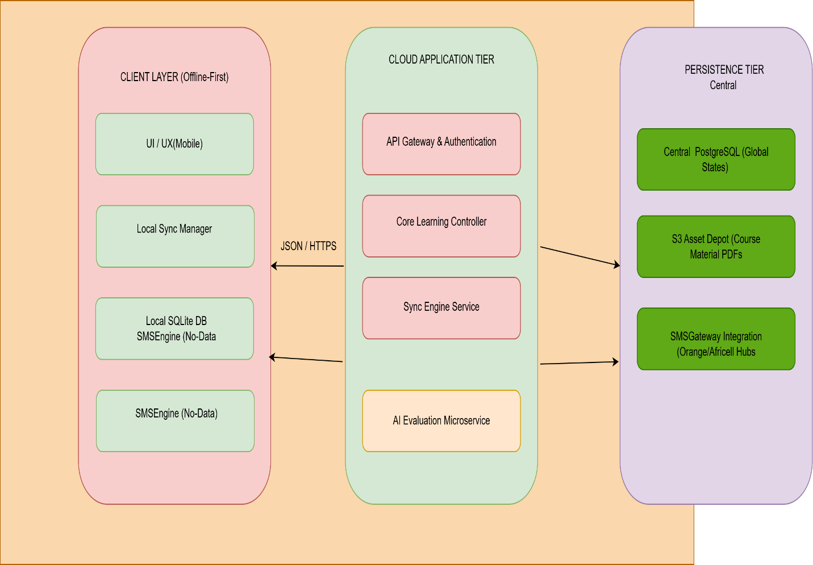
3. SYSTEM ARCHITECTURE DESIGN

Slide 16
3.2 COMPONENT INTERACTIONS
1. Client Layer (The Local "Smart Notebook")
What it is: This is the actual app installed on a student’s or teacher's device (Android phone, Windows laptop, or Linux computer).
How it works: Instead of asking the internet for information every time you click a button, the app talks directly to a small database (SQLite) built right inside the device.
Why it matters: Because the database is inside the phone, the app responds instantly. If the internet drops out completely, the user won't notice any lag or see a loading spinner—the app keeps working perfectly.

Slide 17
3.2 COMPONENT INTERACTIONS
2. Local Sync Manager (The Outbox Checklist)
What it is: This is the app's internal notepad that keeps track of what you did while offline.
How it works: When you finish a quiz, gain a reading streak, or submit an assignment without internet, this manager writes that activity down on a digital "to-do list" (a mutation ledger queue).
Why it matters: It patiently holds onto your progress. The exact moment your phone catches a cellular signal, the manager packages that checklist into tiny, lightweight text files (JSON) and sends them off to the central server automatically.

Slide 18
3.2 COMPONENT INTERACTIONS
3. Sync Engine Service (The Conflict Resolver)
What it is: This is the smart coordinator sitting on the central cloud server (PostgreSQL database).
How it works: When the network comes back, multiple devices might try to update the server at the same time, or one student might have used two different devices while offline. This engine uses a smart sorting system (ID resolution) to figure out exactly what happened first, making sure no data is lost or overwritten incorrectly.
Why it matters: It acts like a referee, neatly organizing and merging all the offline work from thousands of students across Sierra Leone into the master database without causing a digital traffic jam.

Slide 19
3.2 COMPONENT INTERACTIONS
4. AI Evaluation Microservice (The Pocket Tutor)
What it is: This is a highly efficient AI brain that analyzes how the student is doing.
How it works: Instead of using a massive, expensive AI that requires a supercomputer, it uses a scaled-down, "lightweight" AI model. It looks at the student's quiz scores, figures out their weak spots, and creates a customized, bite-sized study plan.
Why it matters: To save internet data, it compresses these study plans into tiny files. It can even turn important study tips and test questions into standard, text-only SMS notifications that can be sent to old-fashioned way.

Slide 20
4. UI/UX INTERACTIVE PROTOTYPE ARCHITECTURE
The EDU Core implementation maps complex user navigation into highly responsive screen layouts developed within Figma. The interface enforces low-contrast, daylight-readable, and highly readable typography (Tahoma-dominant) optimized to consume minimal device processor cycles

Slide 21
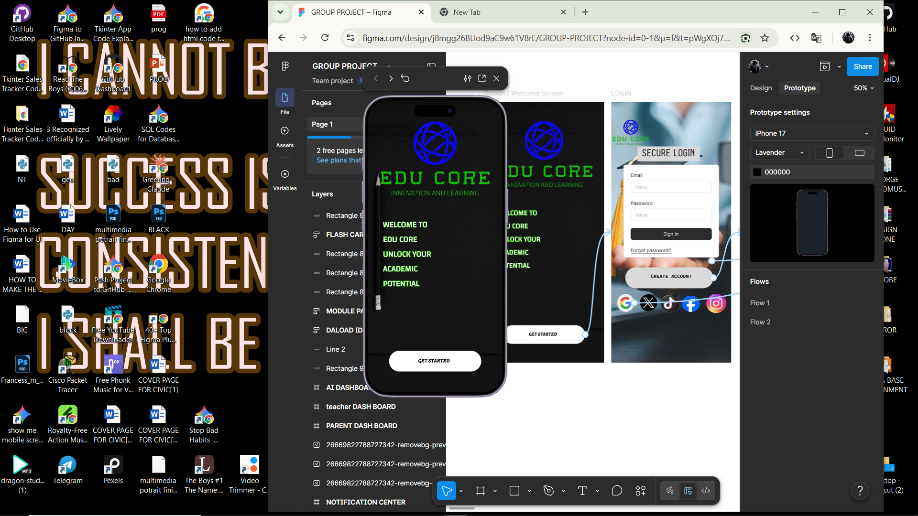
4. UI/UX INTERACTIVE PROTOTYPE ARCHITECTURE
Example screen shot of system first page created within figma

Slide 22
TASK ID | Task Characterization | Estimated Duration | Immediate Predecessor Paths
A | Research, Collection Of Materials, Data processing | 10 | NONE
B | System Specification Blueprinting, Relational Architecture & Database Modeling | 15 | A
C | Figma High-Fidelity and flexibily Interactive frames & Core Screen UX System Definition | 12 | B
D | Local SQL Framework Deployment & Client-Side UI View Development | 20 | C
E | Cloud Application Setup, Sync Engine & PostgreSQL Central Infrastructure Integration | 20 | C
5. PROJECT MANAGEMENT, SCHEDULING, AND NETWORK PLANNING

Slide 23
F | AI Evaluation Microservice Engineering & SMS Gateway Integration | 10 | D,E
G | Comprehensive End-to-End System Testing under Simulated Low-Bandwidth Network | 14 | F
H | Comprehensive End-to-End System Testing under Simulated Low-Bandwidth Network | 6 | G
5. PROJECT MANAGEMENT, SCHEDULING, AND NETWORK PLANNING

Slide 24
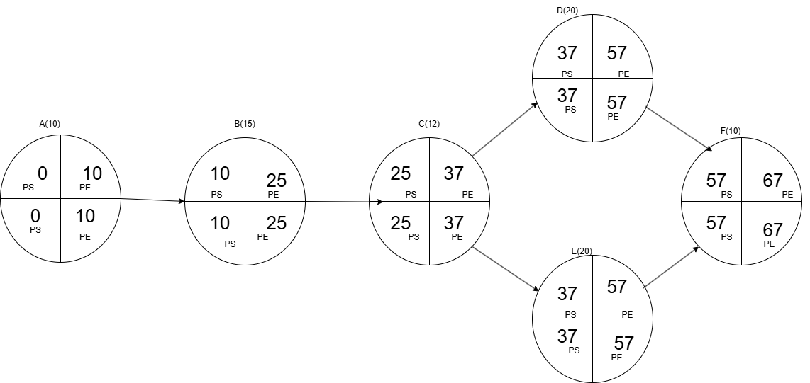
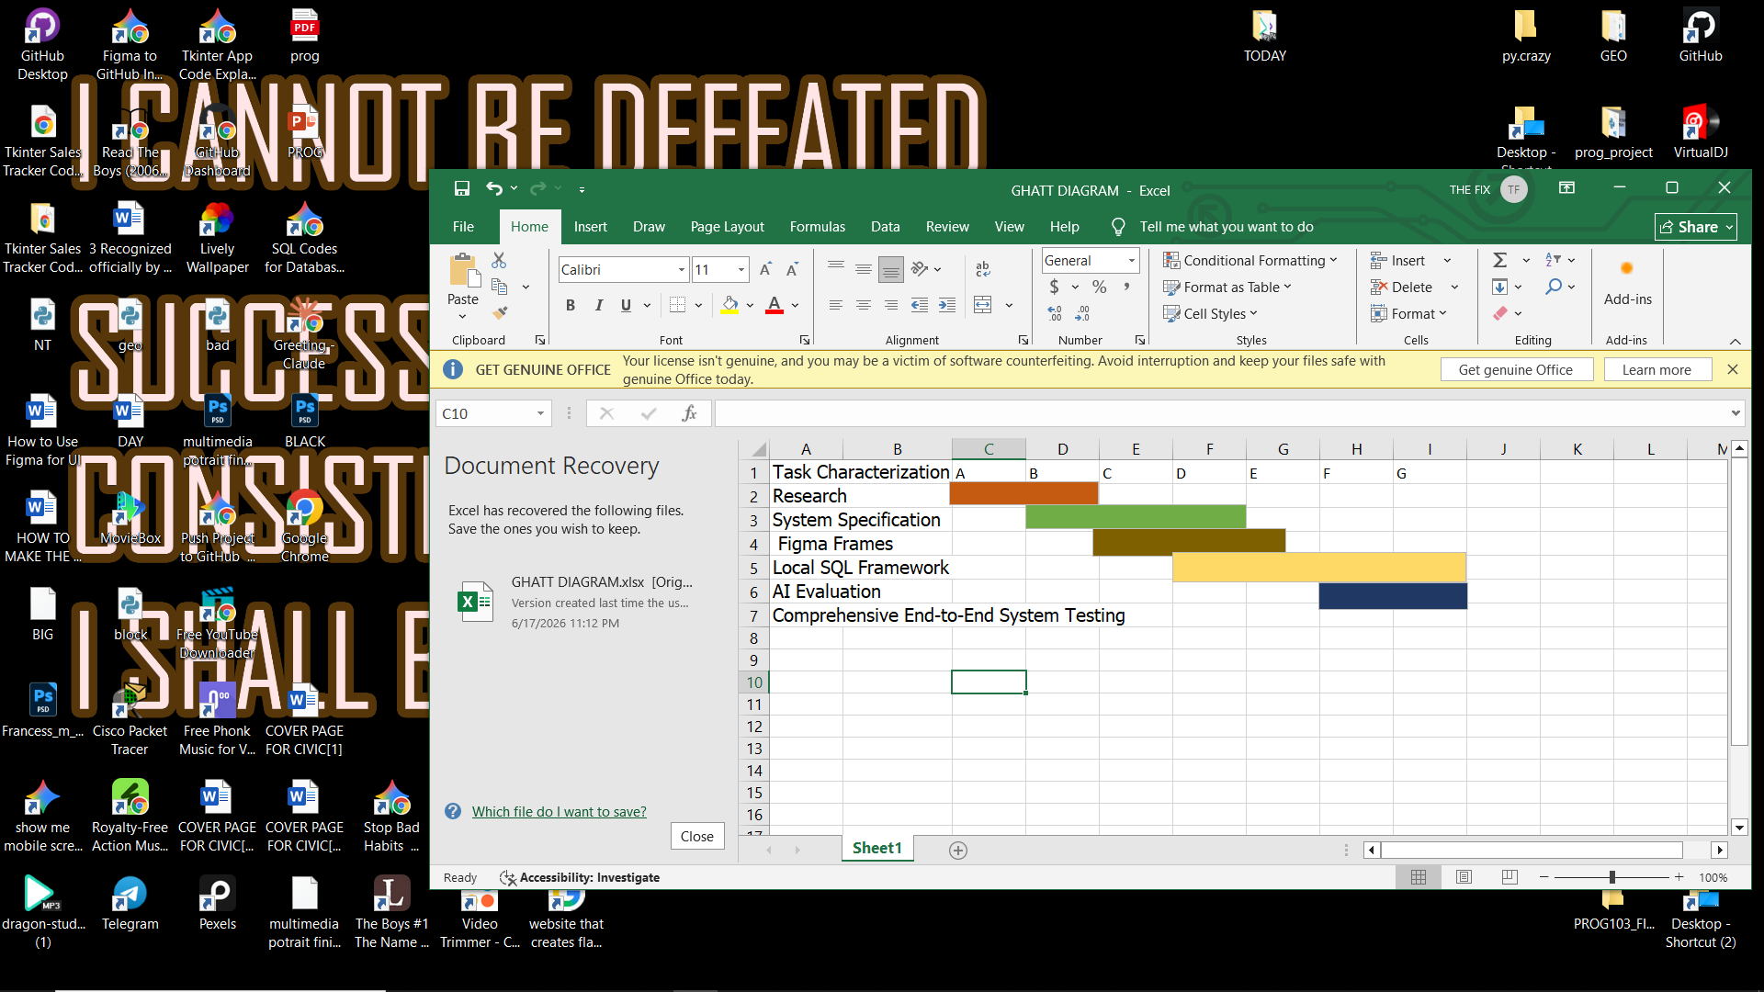
5.2 Network Analysis AND NETWORK DIAGRAM
5.3 GANTT DIAGRAM

Slide 25
6. UN SUSTAINABLE DEVELOPMENT GOAL ALIGNMENT
The development parameters map directly into the indicators specified under SDG 4 (Quality Education):
• Target 4.1 (Free, Equitable, and Quality Primary/Secondary Education): EDU Core removes financial barriers by providing zero-cost digital content and offline operational modes, leveling the playing field for students without steady internet access
7.OPENSOURCE LICENSING FRAMEWORK SELECTION
To comply with the structural criteria defining a Digital Public Good (DPG), EDU Core is released under the MIT License. This permissive licensing choice guarantees that any educational institution, regional municipality, or non-profit organization can freely clone, adapt, modify, and distribute localized instances of the application without licensing fees. This approach encourages regional ecosystem customization across developing markets.

Slide 26
The EDU Core platform provides a robust, production-ready software solution designed specifically for the unique educational infrastructure challenges in Sierra Leone. By integrating an offline-first mobile data architecture, automated local SQLite engines, targeted low-bandwidth SMS reporting metrics, and an open-source development model, the platform delivers an accessible technical architecture that successfully transforms educational delivery. This design sets a strong engineering standard for building effective Digital Public Goods that drive real-world societal impact.
CONCLUSION

Slide 27
THE END

